Slide 1
Presentation of the Case Study
Parker Hegstrom
Robbie Daitzman
Karol Cholody
Tomasz Garyga

Slide 2
Main Objectives
Design and develop a user interface to buy tickets to the cinema
Read and post comments and reviews about films
Look up movies at a certain cinema and vice versa
Look up info on movies
Cinemas, director, plot, cast, photos, and trailers
Look up maps of the locations of the cinemas

Slide 3
Profile of Target Audience
English speakers that are looking for movies in Madrid
Enjoys movies, wants opinions of others and to share opinion
Wants to be as efficient as possible
In finding movie/cinema
Ease of returning to the same website

Slide 4
Similar Web User Interface Fandango.com
Good Practices
Provides many pathways to purchasing tickets
User can purchase tickets for a movie from any page related to that movie
Bad Practices
Home page is too busy and overwhelming
Option to view nearby theaters and movies they play is confusing

Slide 5
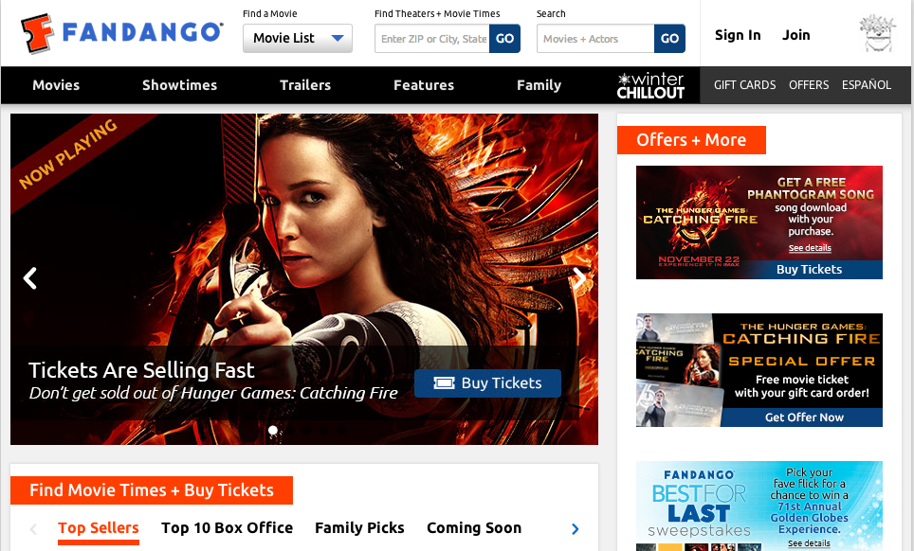
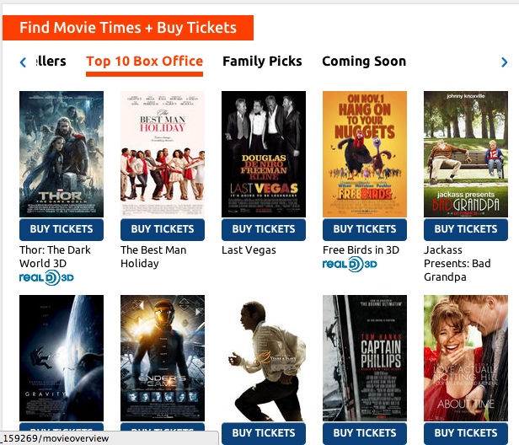
Notes:
Example of the busy Fandango home page
The choice to select a particular zipcode/theater is very small and at the top

Slide 6
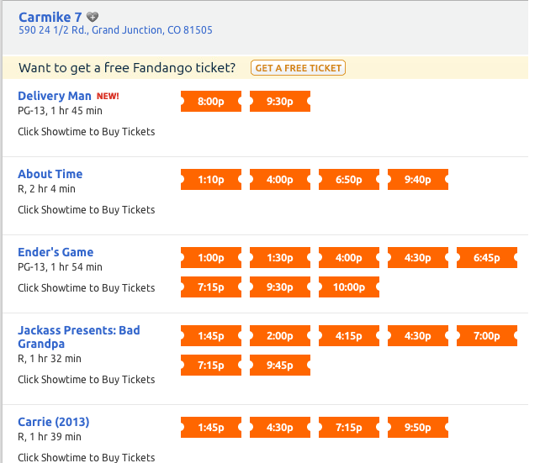
Easy to Use page to see movies
Notes:
Ease of selecting a movie on Fandango, very simple interface
User easily sees the location of the cinema, the available movies, and what times each movie is playing

Slide 7
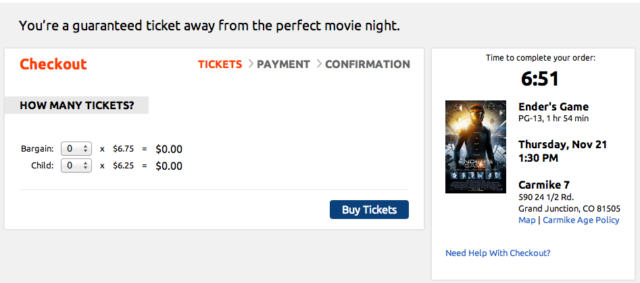
Simple Buying Process
Notes:
Simple buying process, allows user to select quantity and type of tickets on the same page
Price total is always visible to the user.
Page keeps user aware of what step of the process they are on

Slide 8
Similar Web User Interfaces Helios.PL
Good Practices
Process of buying tickets is very linear
On homepage, all movies are shown as pictures of posters with labels
Useful search tool
Tabs on page allow user to look up film by type
User can easily choose seats, map of cinema room is shown
Bad Practices
Reserving tickets is confusing unless user is familiar with the process
Some buttons aren’t easily visible, users must be familiar with the page

Slide 9
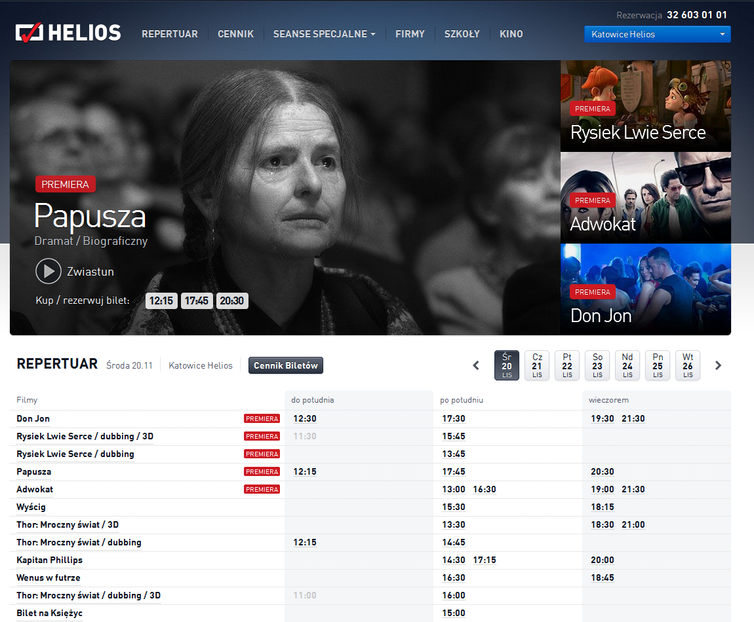
Simple Homepage
Notes:
Homepage of Helios
Shows the showings at one particular cinema, but can be changed at any time

Slide 10
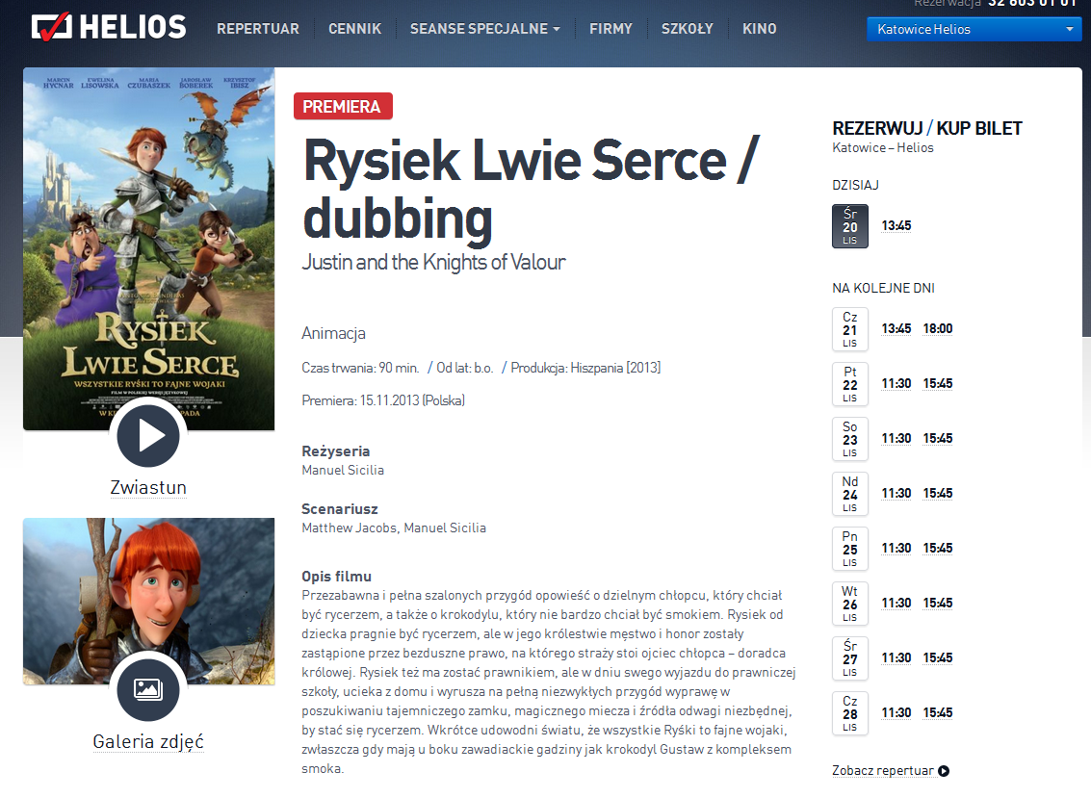
Easy Page with Movie Info
Notes:
Page for a particular movie
Clearly shows all info, trailer, pictures, and showtimes

Slide 11
Similar Web User Interfaces Cinema-city.PL
Good Practices
User can watch trailer of movie and see pictures
Map of cinema room is easily available
Process of buying tickets is very linear, hard to get lost
Bad Practices
Buying tickets can be confusing if the user is not familiar with the page. (User must know to click on name of movie or time of show)

Slide 12
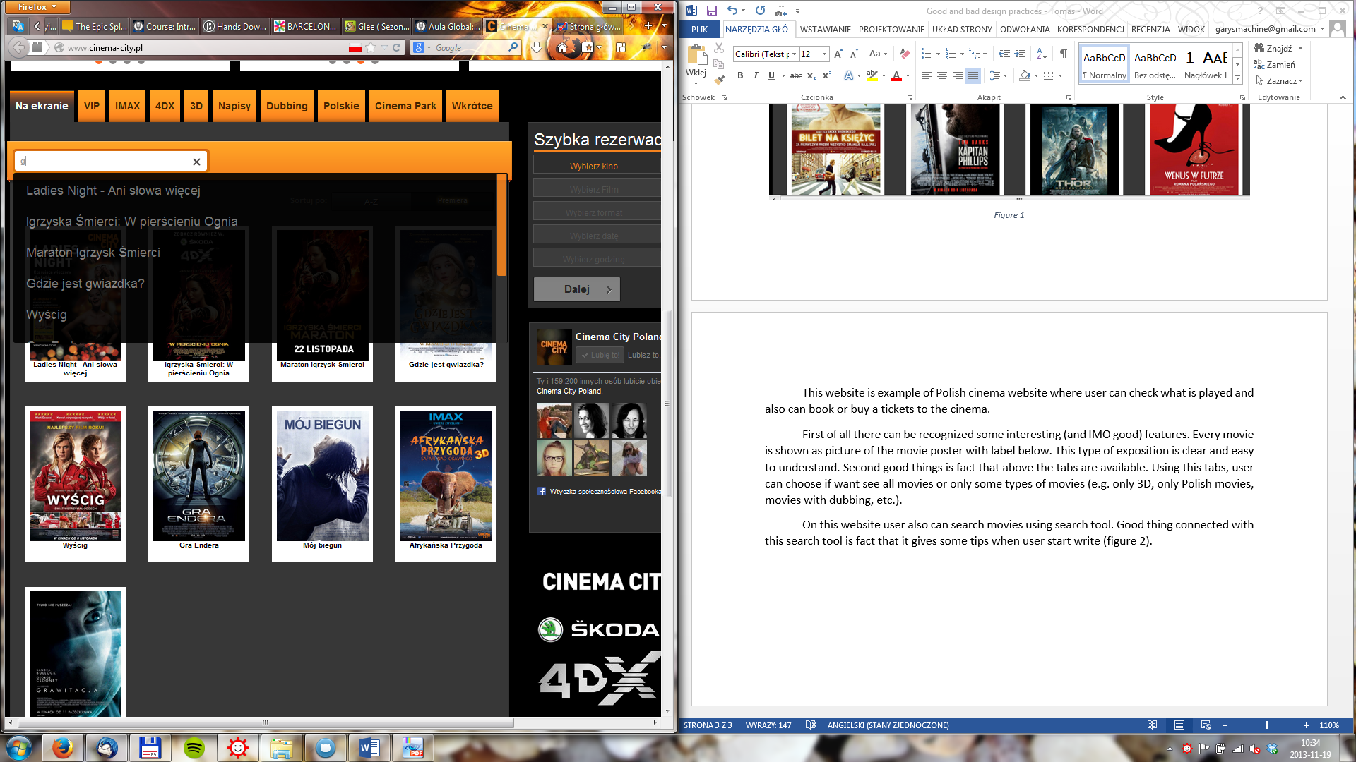
Useful Search Tips

Slide 13
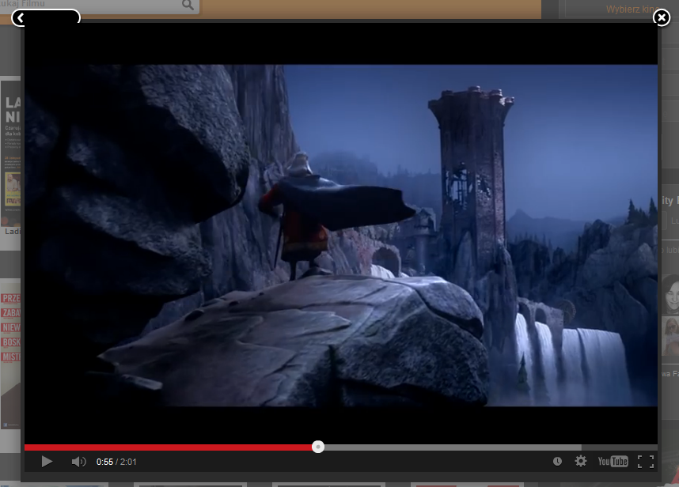
Button Obscured by Trailer

Slide 14
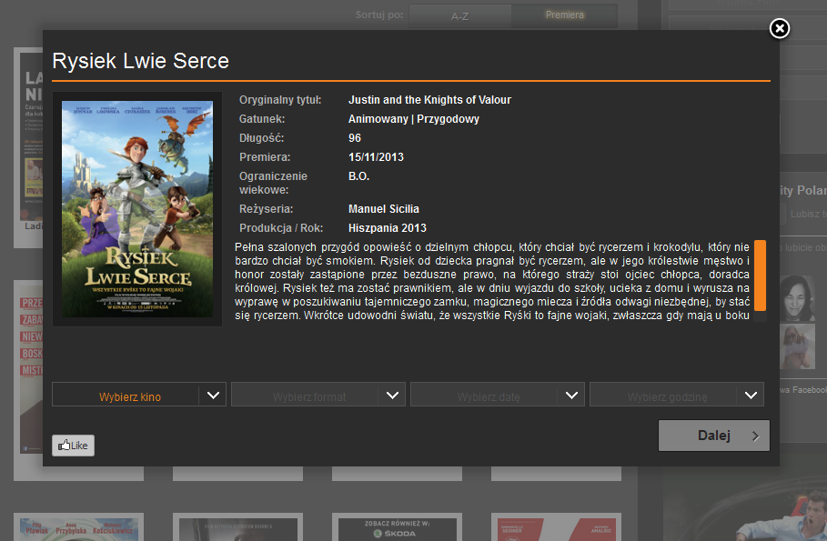
Unclear that user can buy tickets on this page

Slide 15
Low-Level Prototypes

Slide 16
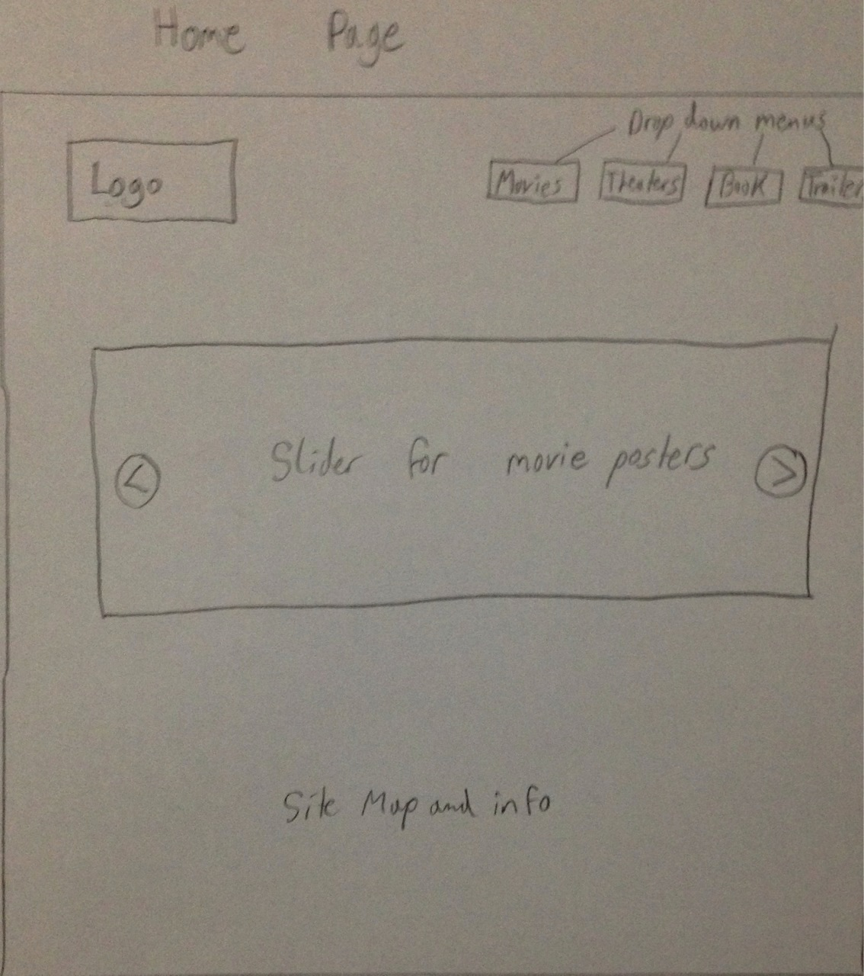
Home Page

Slide 17
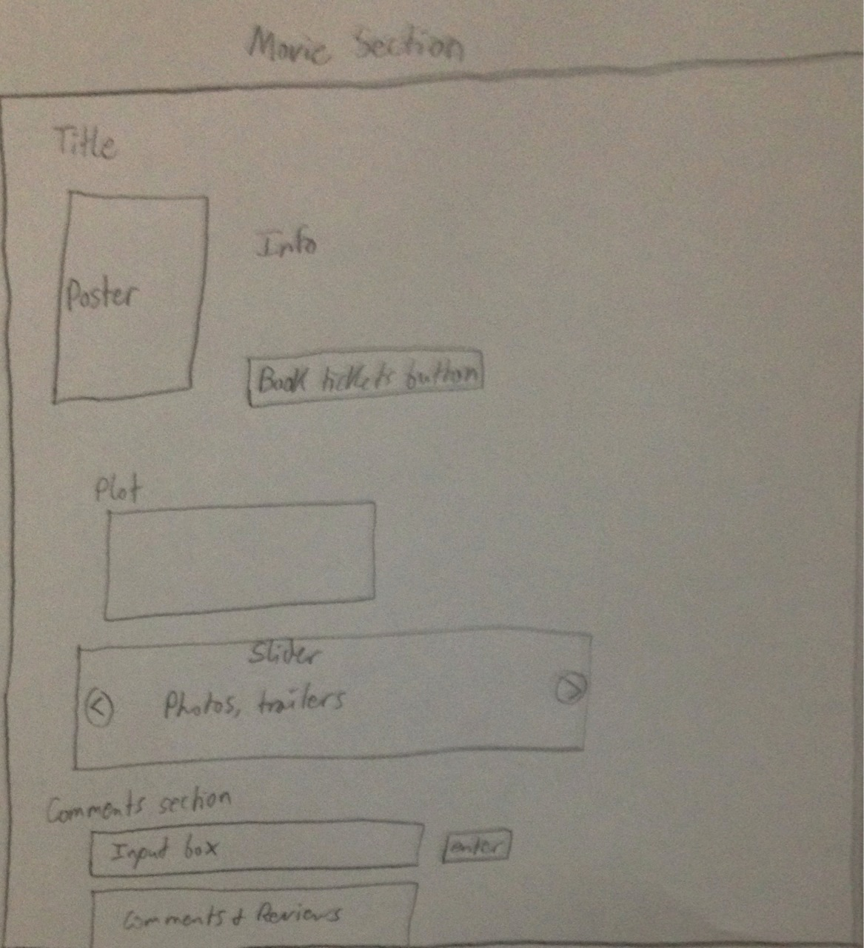
Page for a Movie

Slide 18
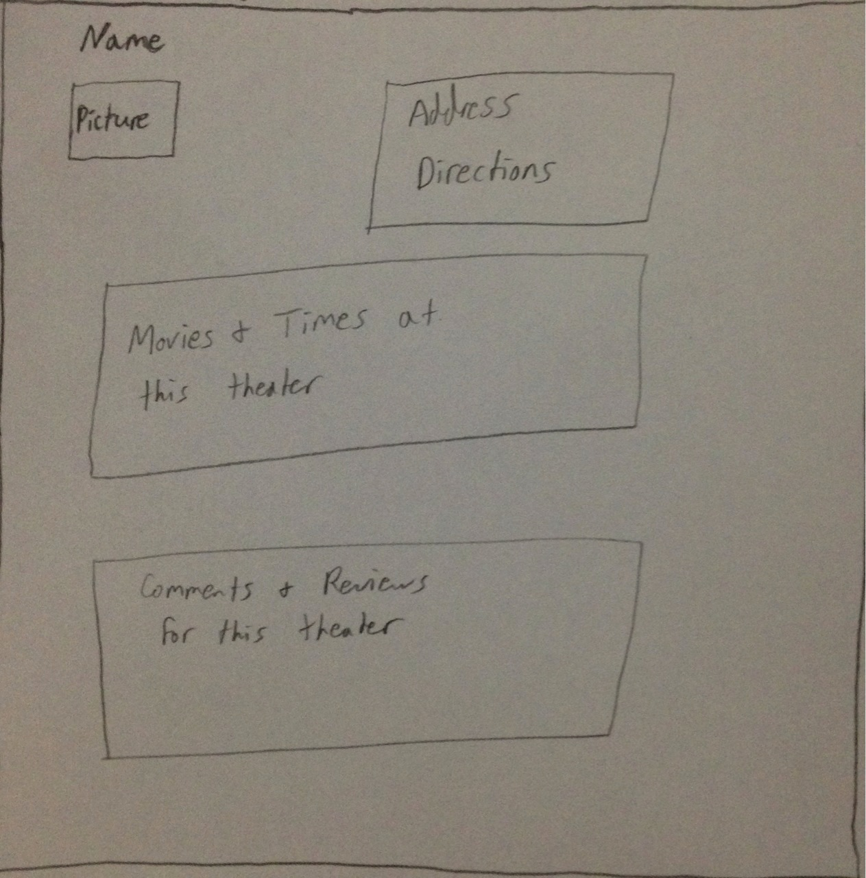
Page for a Cinema

Slide 19
Screenshots of Our Interface

Slide 20
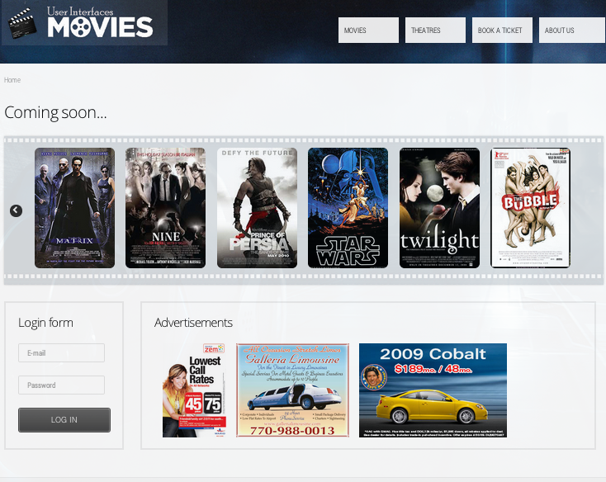
Notes:
Homepage for the website

Slide 21
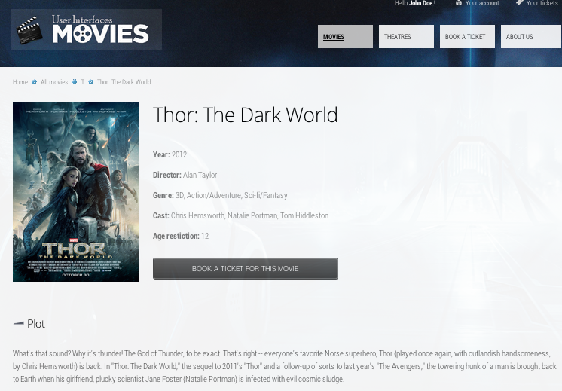
Notes:
Movie page, shows comment section (continued on next slide)

Slide 22
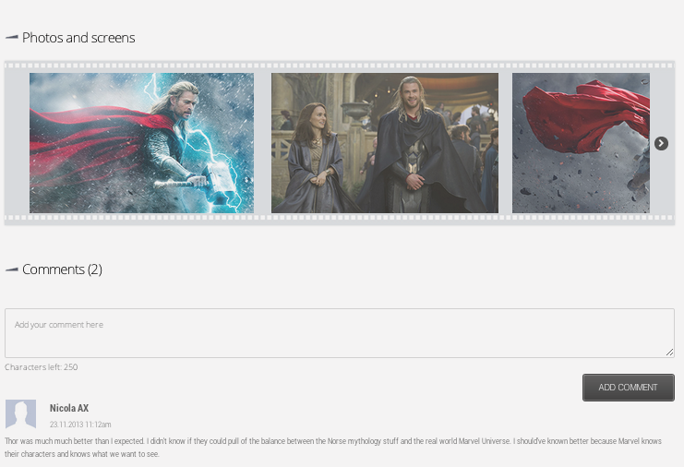
Notes:
Movie page, shows comment section (continued on next slide)

Slide 23
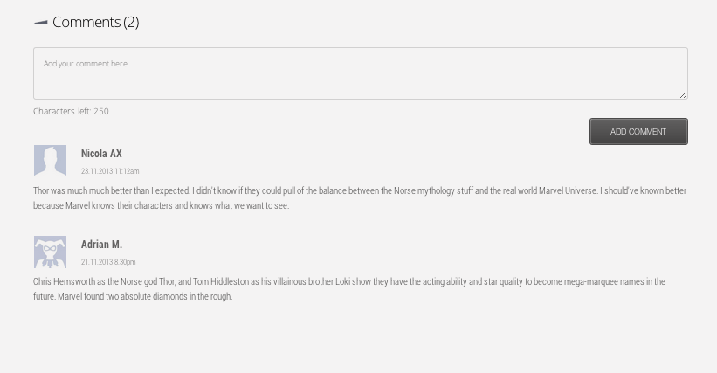
Notes:
Comment section (similar format for reviews of movies and reviews of the movie theaters)

Slide 24
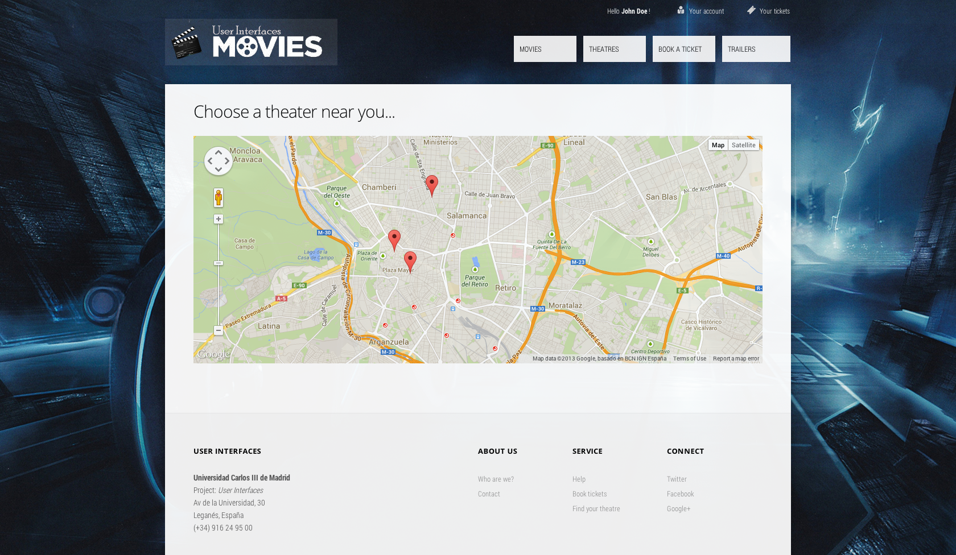
Notes:
Map of the theaters, googleMaps plugin

Slide 25
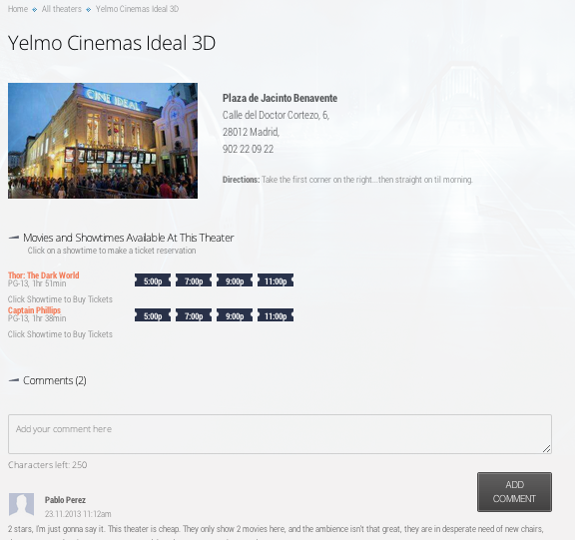

Slide 26
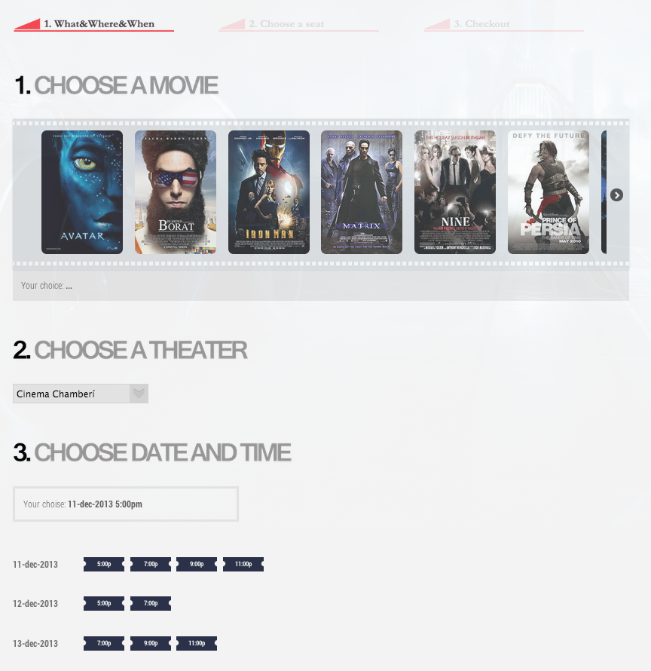

Slide 27
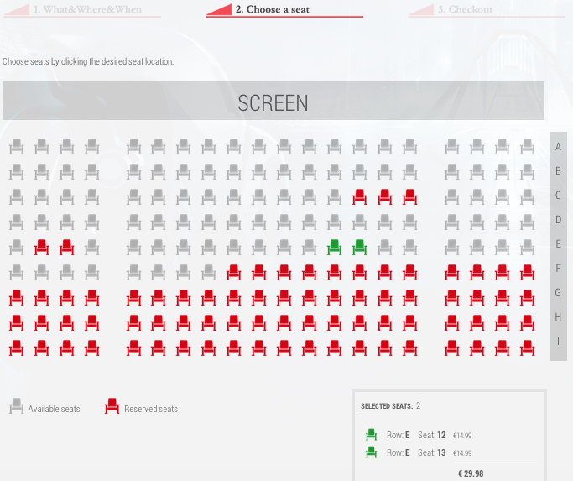

Slide 28
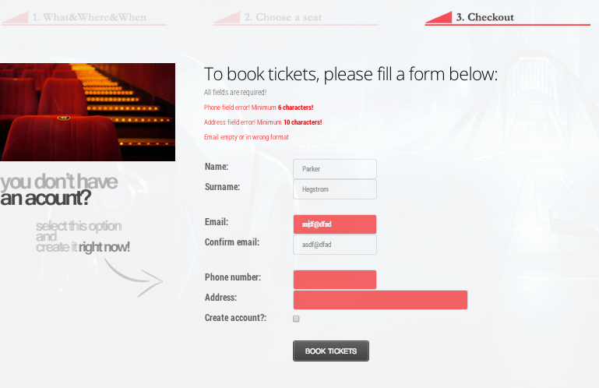

Slide 29
Web Design Patterns Used
Use of Nielsen’s Design Heuristics
Consistent design format across pages
The following slides highlight some of our techniques

Slide 30
Web Design Patterns Used
B Patterns – Multiple ways to come to site
Multiple ways to navigate to buy a ticket (B1)
Multiple ways to find a movie time
Hierarchical and task-based organization (B3 and B4)
Category pages (genre, director, etc) (B8)

Slide 31
Web Design Patterns Used
D Patterns – Managed and Presentable Conten
Consistent page templates (D1)
Personalized content (D4)
Ability to create your own profile
Message boards (D5)
Comments and reviews
Inverted-Pyramid style (D7)
Style Sheets (D11)

Slide 32
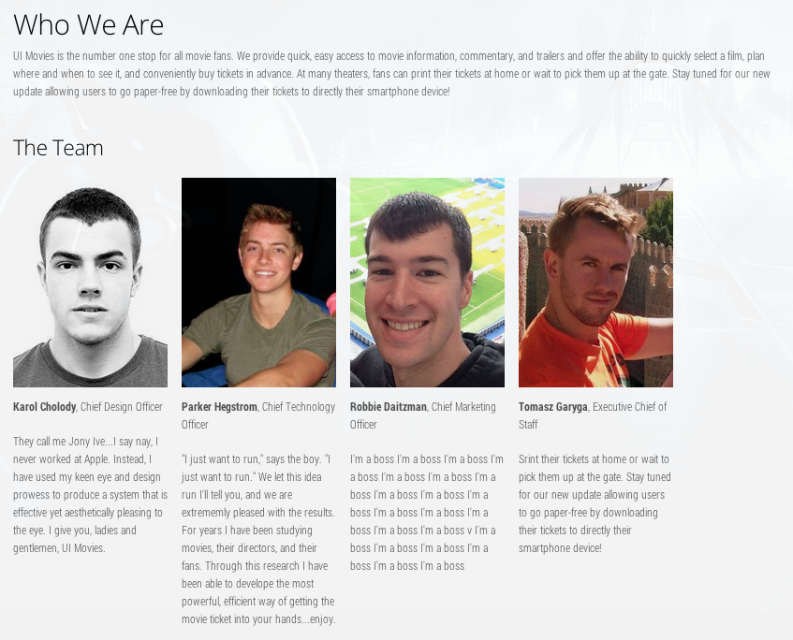
Web Design Patterns Used
E Patterns – Trust and Credibility
Site Branding (E1)
Logo in top left corner
Consistent style
About Us Page (E5)

Slide 33
Web Design Patterns Used
H Patterns – Ease of Use/ Customer Assistance
Sign-in/New Account (H2)
Guest account (H3)
Able to purchase without creating account
Clear, concise forms (H10)
Progress Bar (H13)
Checkout pages

Slide 34
Web Design Patterns Used
K Patterns - Navigation
Unified browsing hierarchy (K1)
High-visibility buttons (K5)
Bread Crumbs – (K6)
Embedded and obvious links (K7 and K10)
Familiar, easy language (K11)
Prevent errors, meaningful feedback (K12 and K13)
On the form to buy tickets

Slide 35
Explanation of Source Code
All pages are connected, but no data is actually saved
Use of a database would aid this
Created one movie page and one theater page
Only to demonstrate the technique and design

Slide 36
Thank you!

